Slide 1
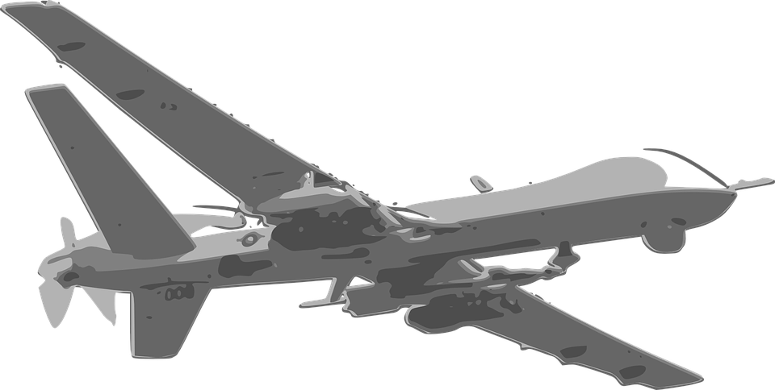
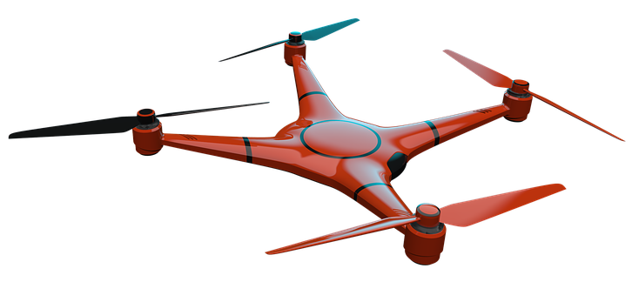
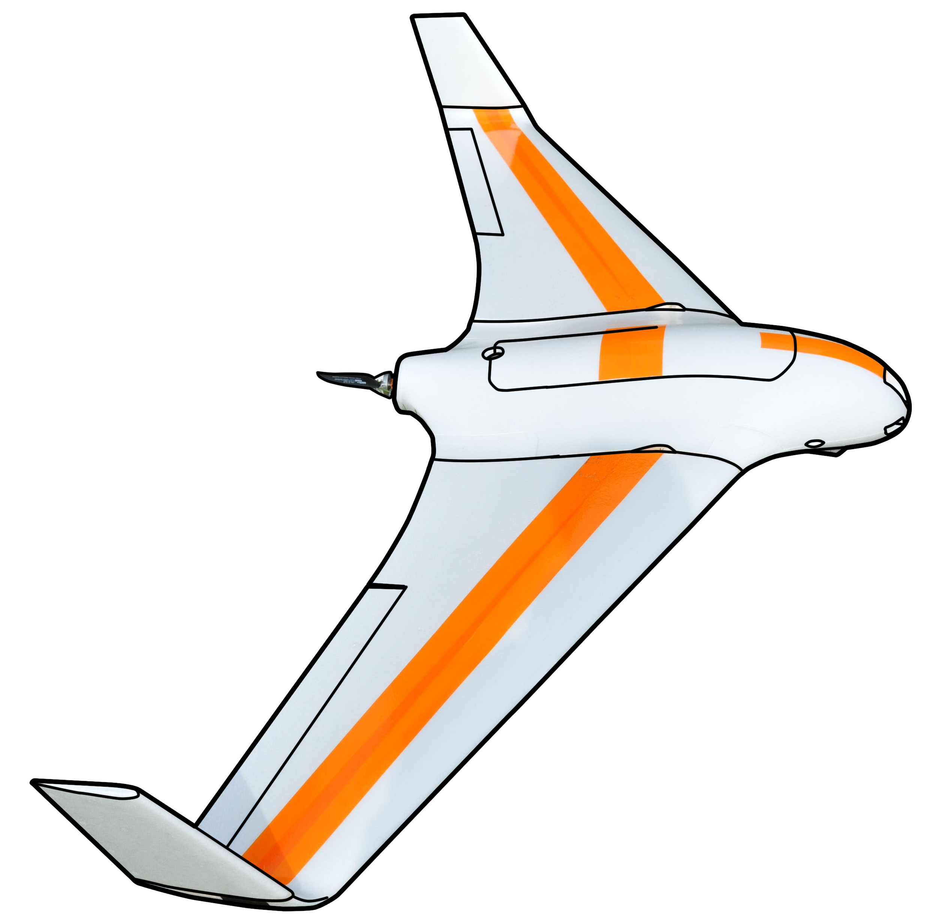
[Explained] Approach to avoidance ACAS-Xu

Slide 2
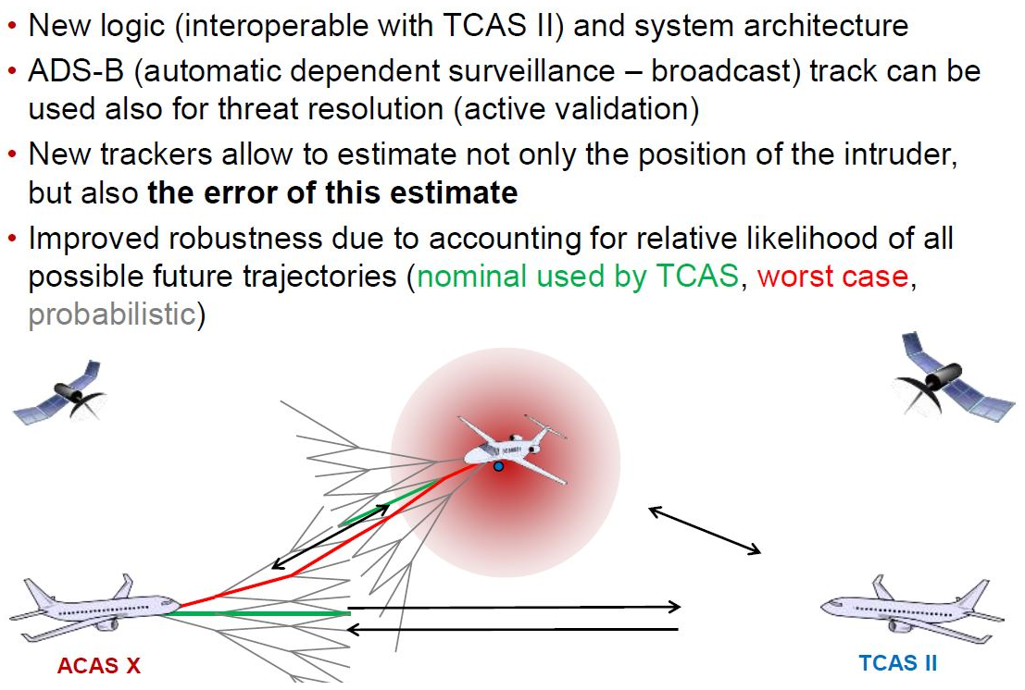
What is ACAS-X

Slide 3
ACAS $X_{A}$ vs. ACAS $X_{U}$
$$\text{RTCA}\text{, }\text{SC}\text{−147, }\text{ACAS} \text{Xu} \text{WG} \text{Kick}\text{−}\text{off}\text{, }\text{January}\text{ 12, 2016}$$

Slide 4
ACAS $X_{A}$ vs. ACAS $X_{U}$
$$\text{RTCA}\text{, }\text{SC}\text{−147, }\text{ACAS} \text{Xu} \text{WG} \text{Kick}\text{−}\text{off}\text{, }\text{January}\text{ 12, 2016}$$

Slide 5
ACAS $X_{A}$ vs. ACAS $X_{U}$
$$\text{RTCA}\text{, }\text{SC}\text{−147, }\text{ACAS} \text{Xu} \text{WG} \text{Kick}\text{−}\text{off}\text{, }\text{January}\text{ 12, 2016}$$

Slide 6
Automatic response downfall
Depending on the communication link, it is expected that there may be significant latency associated with RA data transmission to a ground-based flight crew and subsequent pilot aircraft control commands back to the aircraft in response to the RA
Loss of uplink or downlink communications with the UAS would entirely prevent ground-controlled collision avoidance, and may also degrade collision avoidance effectiveness on other aircraft in coordinated encounters
UAS may also lack additional outside information, such as visual identification of intruders, which allows pilots in manned aircraft to make real-time decisions regarding RA response.
The pilot has the ability to override auto-response at any time before or after the aircraft has started maneuvering

Slide 7
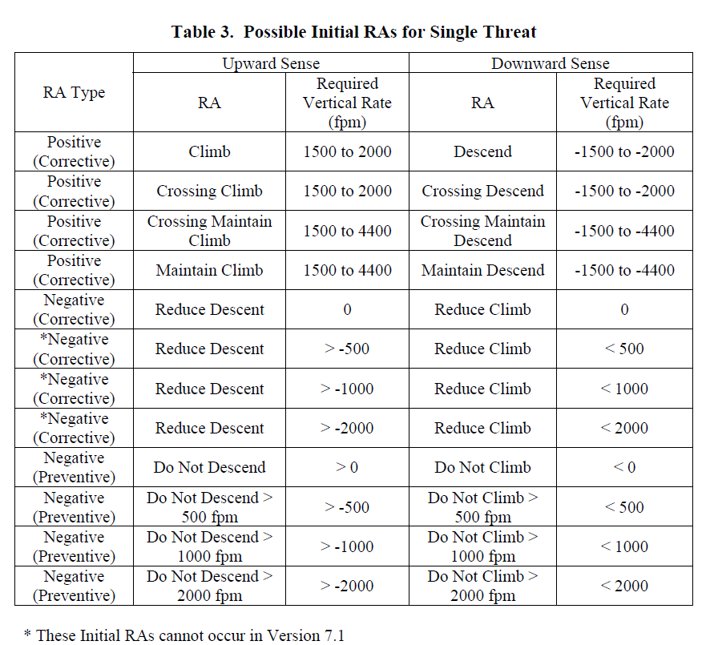
TCAS/ACAS RA advisories (!Horizontal only!)

Slide 8
ACAS Xu Summary
Safety – weather avoidance, mid air collisions
Strategic layer – flight planning (Hours/10^{ths} of minutes) [Mission plan]
Tactical layer – separation (10^{ths} of minutes/minutes) [Other systems]
Emergency layer – Collision avoidance (10^{ths} of seconds/seconds) (ACAS)
ACAS X merits to TCAS II limitations
Reducing nuisance alert rate while improving safety
New classes of users/Adaptation to new operations
Adaptable system allowing different sensors configuration
Backward compatibility with TCAS II
ACAS Xu should guarantee that UAV system does not enter RA zone of manned aviation
ACAS Xu provides look-up table for avoidance maneuvers on horizontal/vertical separation level, which determines vehicle behavior during avoidance
ACAS Xu is designed for big UAVs which are equipped with Transponder

Slide 9
Our Approach Comaprison
Room for improvement:
Emergency autonomous avoidance maneuvers in short term collision situations
When future implementation of ACAS-XU fails,
When maneuver set for ACAS-XU is incompatible with vehicle dynamics
Long term trajectory planning including “virtual obstacles”
Avoid restricted flight areas
Avoid weather obstacles
Rules of air and ”Right of the way” amendment
The rules of the air needs to be amended to define UAV classes
The behavior patterns for UAV classes needs additional parameters
The vertical separation (right-up/down) must be added for UAVs

